Slide 1
CAPSTONE PROJECT REVIEW – III FACE RECOGNITION
Dhruv Mittal
17BCE2110
Ph no: - (+91) 9910887769
Email: dhruv.mittal2017@vitstudent.ac.in
Guide
Prof. Manjula R
Associate Professor Sr.
Ph no: - (+91) 9486464055
Email : rmanjula@vit.ac.in

Slide 2
Abstract
Face recognition identifies the humans by the unique characteristics of their faces. Face recognition technology is the least intrusive and fastest bio-metric technology. With increasing security needs and with advancement in technology extracting information has become much simpler.
Face recognition is of great importance to real world applications such as video surveillance, human machine interaction and security systems. As compared to traditional machine learning approaches, deep learning-based methods have shown better performances in terms of accuracy and speed of processing in image recognition
It involves two main steps. First to detect the face of a person and identify the distinguishing factors in image and storing them and Second step to compare it with the existing images and returning the data related to that image.
We will implement this project in two parts first is to detect the face of a person, and data collection which is done using Opencv library and second part is model training and Face recognition.
Keywords— Face recognition, biometrics, Deep learning.

Slide 3
Aim and Objective of the proposed Work
This project aims on building an application based on face detection and recognition. The most basic purpose is to identify the face and retrieving information stored in database
Our aim in this project is to first detect face and compare it with the faces in our database and then recognize the person. We intend to build a system which has many applications in future as stated above with high accuracy.
Our primary objective is to detect the faces in the live camera using Opencv library and store it as a dataset. Here we are detecting the faces and creating the dataset for our project at the same time.
After the dataset collection is done, we will use Transfer Learning techniques to train the images and our model and use this model further to create an Interface which would detect the face in front of camera actually tell us the name of the of the person in front of web cam.

Slide 4
Methodology Adapted
In this project first we are going to collect the data for dataset through our laptop integrated camera using OpenCV library and Haar Cascade Classifier which will be responsible in finding and detecting the faces in frames. Using this methodology, we will be able to store our captures images in a particular folder as our dataset required.
For our Model training purpose, we will be using Transfer Learning technique that is InceptionResNetV2. InceptionResNetV2 is a Convolutional Neural Network that is trained on more than a million images from the ImageNet database.
It is a Keras pre trained model for image classification. The network is 572 layers deep and can classify images into 1000 object categories, such as keyboard, mouse, pencil, and many animals. As a result, the network has learned rich feature representations for a wide range of images.

Slide 5
Theoretical Background
Biometrics research investigates methods and techniques for recognizing humans based on their behavioral and physical characteristics or traits ace recognition is a biometric trait and it is something that people usually perform effortlessly and routinely in their everyday life and it is the process of identifying individuals from their faces’ intrinsic characteristics.
Automated face recognition has become one of the main targets of investigation for researchers in biometrics, pattern recognition, computer vision, and machine learning communities.

Slide 6
Motivation
Face recognition makes it easier to track down burglars, thieves and trespassers. The technology is could also be integrated in CCTV cameras for surveillance purposes and monitoring.
This technology can also be used by Forensics team for criminal investigation purposes or identify someone’s identity based on his face image only.
The technology isn't limited to tracking down criminals. For instance, it could also make it easier to seek out missing children and seniors. Face recognition could make security checkpoints at airports less intrusive to passengers.
This type of prototype can also be used in work places and even in universities for attendance systems where it would recognize faces and automatically mark attendance of an individual. Since this process is faster than traditional roll call systems it saves much time and employees don’t have to prove their identities or clock in with plastic cards.

Slide 7
Introduction and Related Concepts
OpenCV Library- OpenCV is a library of programming functions mainly aimed at real-time computer vision. OpenCV was built to provide a common infrastructure for computer vision applications and to accelerate the use of machine perception in the commercial products.
Transfer Learning- Transfer learning is a machine learning method where a model developed for a task is reused as the starting point for a model on a second task. Transfer learning is extremely popular in Deep Learning since the “transfer” of knowledge from one “parent” model to a “child” model means that the “child” model can be trained to high accuracies with a much smaller dataset compared to the “parent” model. Keras Applications are deep learning models that are made available alongside pre-trained weights. These models can be used for prediction, feature extraction, and fine-tuning.

Slide 8
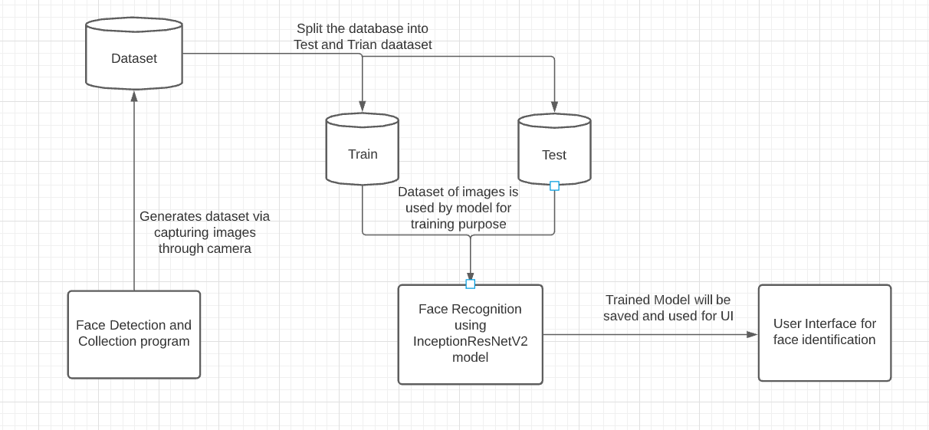
System Architecture/ System Model

Slide 9
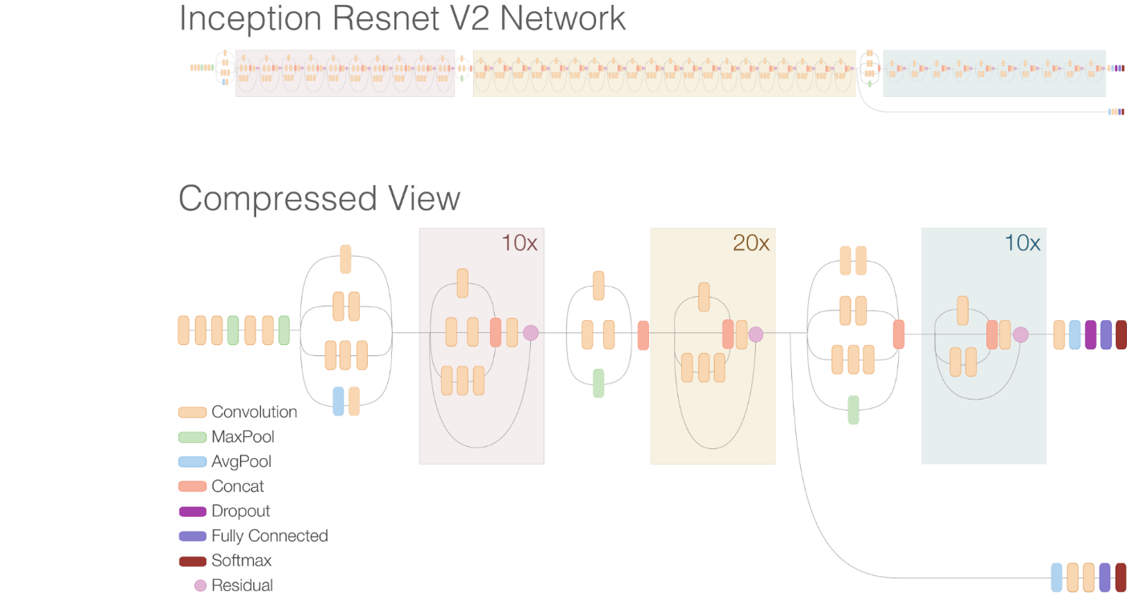
Framework, Architecture or Module for the Proposed System
As we can see this is a compressed view of InceptionResNetV2 which comprises of several layers and has 572 layers of depth. This is a model and application provided by keras library. It’s a pre trained model used for the famous database called “Imagenet” for image classification, where it could classify thousand different objects.

Slide 10
Proposed System Analysis
Our Proposed System starts with the face detection along with the dataset collection in a particular folder via live web cam using Opencv library and Haar Cascade Classifier. After the dataset has been generated, we now make use of this dataset to separate the Training images and Testing images manually.
Now this well defined dataset with separate Training and Testing images can be used to train our model by making the us of Transfer Learning technique called InceptionResNetV2 provided by Keras library.
Keras gives flexibility to use TensorFlow very properly apart from that, it also helps in fine tuning the model very nicely.

Slide 11
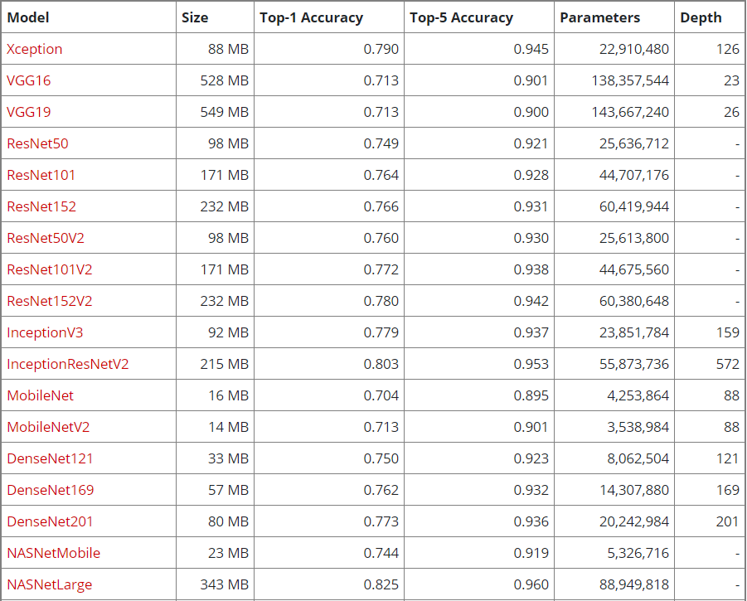
The reason we choose InceptionResNetV2
Source: https://keras.io/api/applications/

Slide 12
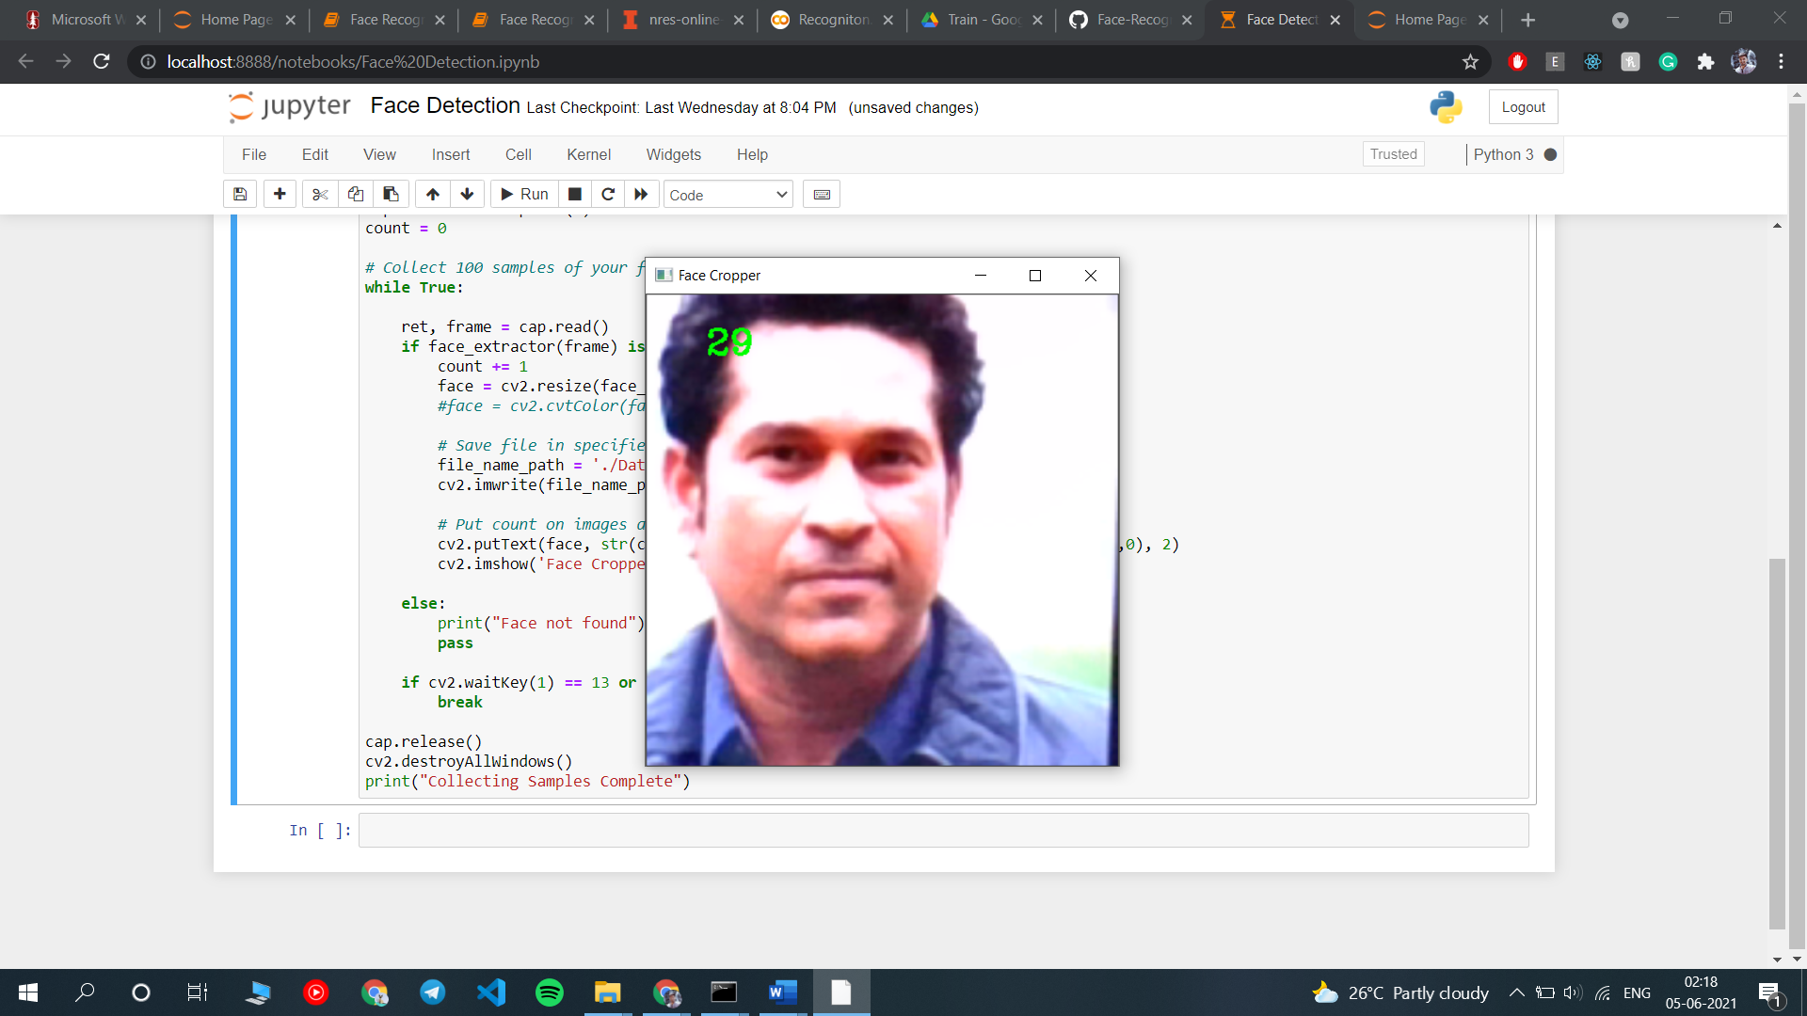
Results and Discussion Face Detection

Slide 13
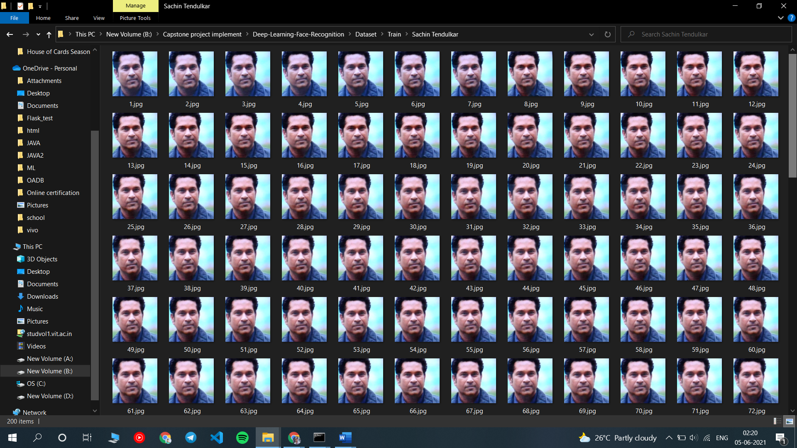
Results and Discussion Data Collection

Slide 14
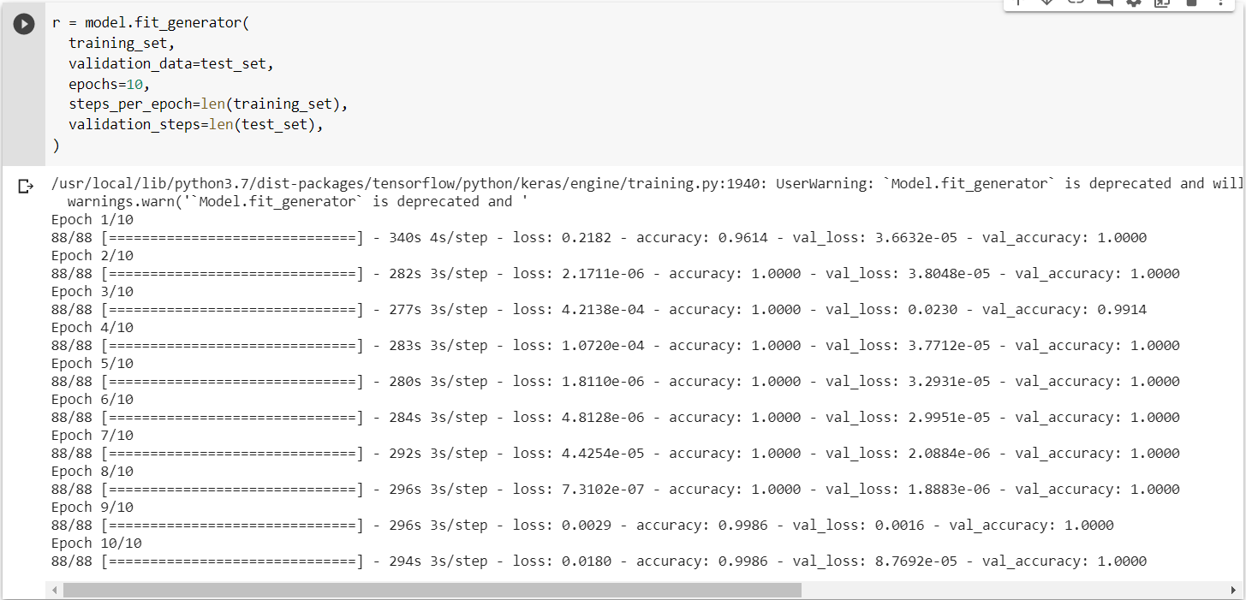
Model Training

Slide 15
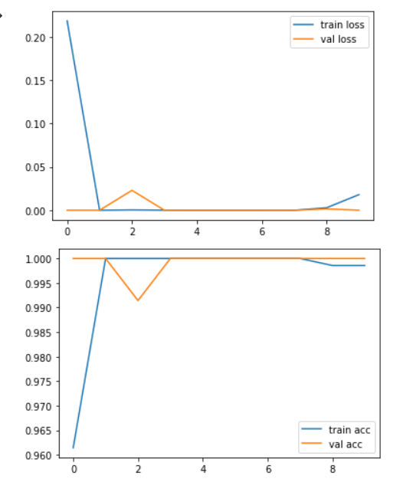
Graphical Output

Slide 16
Results and Discussion Face Detection
As we can see our face detector is successfully able to detect a face from the whole view visible to the web camera, moreover the counter of frames also seems to be perfect which counts how many images have been captured. Like this we have captured a total of 2100 images, 1400 for training and 700 for testing dataset.
As we can see we are able to get training accuracy on average about 99% and validation accuracy average 99%. Even the training and validation loss during the model training has appeared to be very less which is quite good for the model generation.

Slide 17
CONCLUSION
We did train our model with accuracy of about 99% on average but the system seems to predict the face wrongly, we will try to improve the results of the system and come out with a good accuracy.
If we talk about the future of the project, face recognition can be enhanced using an automated Application which will have a much user friendly UI so that the user could feed his face image into the database using the interface instead of running the codes.
There is a drawback here, we create a dataset using face detection and generate the model out of it, but if we have to add more human faces in the dataset, we would have to train the model again, like any other machine learning model as the dataset has changed and model won’t be able to predict the new individual in the dataset which takes some time depending on the computer to computer, but this process is slow.

